Slide 1
OIS 6660
Adam Tidwell
11/20/14

Slide 2

Agenda
Quiz
Special Topic: HR
Discussion
Human Resource Management
Communications
Group project
Create HR Management Plan
Create Communications Plan

Slide 3

Quiz 6
On Canvas
25 minutes
Closed book/internet

Slide 4
Special Topic
Human Resources
Liz Price, PMP

Slide 5
Discussion
PMBOK:
Chapter 9, Project HR Management
Chapter 10, Project Communications Management

Slide 6
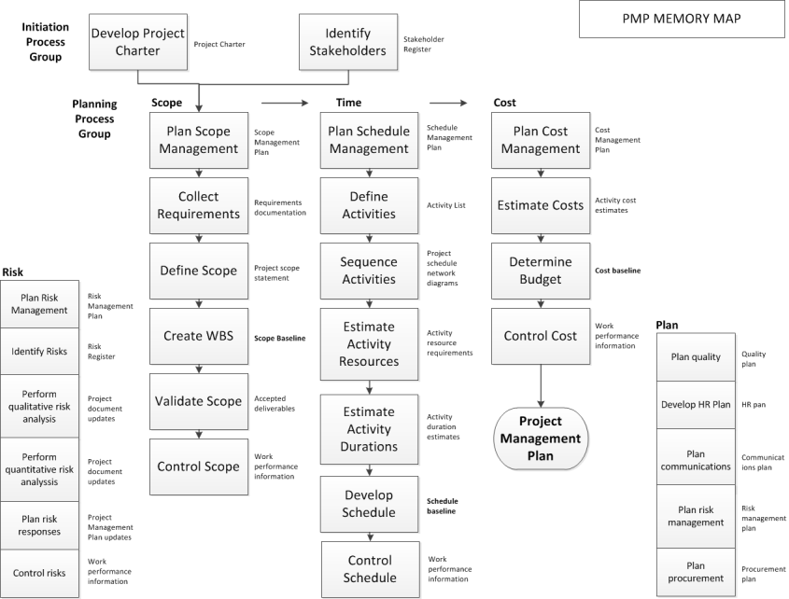
Notes:
Real time decision making – what is scope? Keep your project team focused. For a project manager, lot of responsibilities, less decision making, can influence decisions.

Slide 7
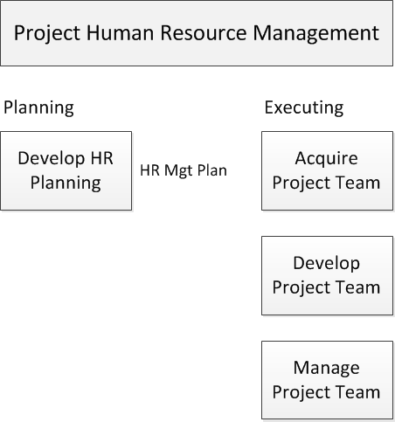
Project Human Resource Management
Notes:
Plan HR Management- process of identifying and documenting project roles, responsibilities, required skills, reporting relationships, and creating a staffing management plan. The key benefit of this process is that it established project roles and responsibilities, project organization charts, and the staffing management plan including the timetable for staff acquisition and release. How are we going to do this? How are we going to hire people?
Acquire Project Team- process of confirming human resource availability and obtaining the team necessary to complete project activities.
Develop Project Team- Process of improving competencies, team member interaction, and overall team environment to enhance project performance.
Manage Project Team- process of tracking team member performance, providing feedback, resolving issues, and managing team changes to optimize project performance.

Slide 8
Plan HR Management
What do you need to know when you bring someone onto a project?
Notes:
HR Management Plan Contains:
Roles and responsibilities, personalities (how do they fit)
Org chart/structure
Staffing plan
When and how, for how long, whats their future after project ends.

Slide 9
Tools & Techniques
Hierarchal Chart- org chart
Matrix Based (RACI/RASCI)
Text-oriented- job descriptions

Slide 10
Org Chart
Notes:
Very labor intensive at the above (in the picture above) (president has lot of work)
Helps to understand who they need to talk to and what gets done.

Slide 11
RASCI
RASCI Project X | CELT | BEX | Quality | L&OD | IC | Ops | WFM | Finance | OS | Tools
Solution design/war room | A | R | S |  | I | S | C | C |  | S
Pilot observations | A | R | C |  |  | S | I |  | I
Approval | R, A | S | S |  | C | C | C | C | C | C
Communications | A, S | R | S | R | S | A | I | I | S, C | I
Quality calibrations | I | A | R |  | I | S |  |  | I | S
Expansion | A | R | C | C | C | A, S | I | I | R | C
 | R | Responsible
 | A | Accountable
 | S | Supporter
 | C | Consulted
 | I | Informed
Notes:
R = Responsible Person who is ultimately responsible for delivering the project. Project manager
A = Accountable Person who has ultimate accountability and authority; who “R” is accountable to. Makes sure there are resources.
S = Supportive Person who is needed to do the work. Subject matter experts
C = Consulted Person who’s input adds value. Participates in project and adds valuable piece
I = Informed Person who needs to be notified of results or actions. Need to give status reports and presentation to them.
Helps keep you organized.

Slide 12
Job Descriptions
Position Title Sr. Leader, Portfolio Management Office
Requisition Number 107841BR
Category Customer Support
Subsidiary eBay
Position Location Germany - Berlin, Ireland - Dublin, US - California - San Jose, US - Utah - Salt Lake City
Shift Day
Education Bachelors Degree or Equivalent
Grade 27
Job Responsibilities The Sr. Leader, Portfolio Management Office (PMO) is a critical global role in Global Program & Project Management as part of GCX, Global Customer Operations. Global Program & Project Management (GPPM) delivers professional project management services to help accelerate growth, drive greater disciplined innovation and focus on our most critical business priorities, while providing visibility to our investments, resource capacity and functional scalability.The Sr. Leader will be responsible for developing and leading a strategically oriented project portfolio management office, maintaining a view of Marketplaces and GCX business objectives and ensuring that GCX projects and investments are aligned with evolving organizational priorities. This individual will oversee portfolio governance of proposed and active programs/projects and will develop and deploy a prioritization method that balances alignment with business strategy, customer demand, and risk/return, and accelerate projects through resource allocation and performance tracking to ensure successful delivery. This role is also responsible for developing and maintaining robust yet flexible project management methodology, execution framework, and tools to drive value, quality and repeatability across GCX. This role requires a blend of business acumen, communications, executive presence, leadership, strategy development, tactical ability and project management skills.The Sr. Leader, Portfolio Management Office will have primary accountability over four key areas of focus: 1) Portfolio Management & Insights, 2) Planning, 3) Demand & Capacity Management, and 4) Methodology & Standards.
Job Requirements Develop and lead a robust portfolio management process for the evaluation and prioritization of programs and projects. Lead and facilitate the GCX Global Council as the key governance committee to prioritize and optimize the portfolio and to give insight to progress, resource capacity, and changes associated with management of the portfolio. Facilitate program / project management resource allocation, enabling efficient advancement to the proper project life-cycle phase (e.g., discovery, definition, design, etc.) and ensure the appropriate level of project participation is available from the business. Reviews project interdependencies for evaluating program alignment or integration, and articulates trade-offs with prioritization decisions. Actively lead a pipeline management process to prepare for future business objectives, portfolio needs and effective utilization of capacity. Monitor portfolio performance and develop improvement strategies to improve the effectiveness of the project management service, and to maximize returns across all projects and programs. Ensure the creation and maintenance of appropriate and effective progress reporting methods. Build capabilities to improve accuracy for estimating and managing the financial elements of projects; inclusive of business cases, financial controls, benefits realization, etc. Synthesize portfolio status and stakeholder input to facilitate and guide executive-level discussions and decision-making. Actively lead and engage in the annual planning process, identifying project roadmaps, budget and resource / talent requirements. Develop and manage stakeholder relationships across Marketplaces and GCX (product / technology / and functional business areas), to ensure effective pipeline and portfolio management. Engage with cross-functional leaders to analyse objectively the organization’s ability to absorb change. Drive the creation and adoption of a Project Execution Framework to drive PPM maturity, consistency, repeatability and quality results through every stage of a project life-cycle. Create a “service approach” to harmonize project management methodologies with practicality and value-add focus; recognizing program / project managers as a core customer. Builds and manages strong working relationships across the organization through excellent communication, customer service, and work product delivery.
Notes:
The above one is too vague. People can get lost. Cant hire right people.
Try to be more clear and precise.
Position Title Sr. Leader, Portfolio Management Office
Requisition Number 107841BR
Category Customer Support
Subsidiary eBay
Position Location Germany - Berlin, Ireland - Dublin, US - California - San Jose, US - Utah - Salt Lake City
Shift Day
Hiring Manager Barbra Peterson
Recruiter Michael Hinrichsen
Education Bachelors Degree or Equivalent
Grade 27
Job Responsibilities The Sr. Leader, Portfolio Management Office (PMO) is a critical global role in Global Program & Project Management as part of GCX, Global Customer Operations. Global Program & Project Management (GPPM) delivers professional project management services to help accelerate growth, drive greater disciplined innovation and focus on our most critical business priorities, while providing visibility to our investments, resource capacity and functional scalability.The Sr. Leader will be responsible for developing and leading a strategically oriented project portfolio management office, maintaining a view of Marketplaces and GCX business objectives and ensuring that GCX projects and investments are aligned with evolving organizational priorities. This individual will oversee portfolio governance of proposed and active programs/projects and will develop and deploy a prioritization method that balances alignment with business strategy, customer demand, and risk/return, and accelerate projects through resource allocation and performance tracking to ensure successful delivery. This role is also responsible for developing and maintaining robust yet flexible project management methodology, execution framework, and tools to drive value, quality and repeatability across GCX. This role requires a blend of business acumen, communications, executive presence, leadership, strategy development, tactical ability and project management skills.The Sr. Leader, Portfolio Management Office will have primary accountability over four key areas of focus: 1) Portfolio Management & Insights, 2) Planning, 3) Demand & Capacity Management, and 4) Methodology & Standards.
Job Requirements Develop and lead a robust portfolio management process for the evaluation and prioritization of programs and projects. Lead and facilitate the GCX Global Council as the key governance committee to prioritize and optimize the portfolio and to give insight to progress, resource capacity, and changes associated with management of the portfolio. Facilitate program / project management resource allocation, enabling efficient advancement to the proper project life-cycle phase (e.g., discovery, definition, design, etc.) and ensure the appropriate level of project participation is available from the business. Reviews project interdependencies for evaluating program alignment or integration, and articulates trade-offs with prioritization decisions. Actively lead a pipeline management process to prepare for future business objectives, portfolio needs and effective utilization of capacity. Monitor portfolio performance and develop improvement strategies to improve the effectiveness of the project management service, and to maximize returns across all projects and programs. Ensure the creation and maintenance of appropriate and effective progress reporting methods. Build capabilities to improve accuracy for estimating and managing the financial elements of projects; inclusive of business cases, financial controls, benefits realization, etc. Synthesize portfolio status and stakeholder input to facilitate and guide executive-level discussions and decision-making. Actively lead and engage in the annual planning process, identifying project roadmaps, budget and resource / talent requirements. Develop and manage stakeholder relationships across Marketplaces and GCX (product / technology / and functional business areas), to ensure effective pipeline and portfolio management. Engage with cross-functional leaders to analyse objectively the organization’s ability to absorb change. Drive the creation and adoption of a Project Execution Framework to drive PPM maturity, consistency, repeatability and quality results through every stage of a project life-cycle. Create a “service approach” to harmonize project management methodologies with practicality and value-add focus; recognizing program / project managers as a core customer. Builds and manages strong working relationships across the organization through excellent communication, customer service, and work product delivery.

Slide 13
Acquire Project Team
Pre-assignment
Negotiation
Acquisition
Virtual teams
Multi-criteria decision analysis
Source: www.isixsigma.com
Notes:
Pre-assignment- you are part of the project because you have special skills or the project is about you. Example – buy company for technology and get their people too.
Negotiation- asking for resources form others.
Acquisition- hiring form outside, consultants, sub-contractors, etc. drawback is they don’t know the culture and people.
Virtual teams- Positives and negatives to not working face to face.
Rating multiple factors in deciding who should work on a project (availability, cost, experience, ability).

Slide 14
Project Team Roles
Executive Sponsor
Sponsor
Program Manager
Project Manager
Project Team
Customer
PMO
Ops Managers
Notes:
Executive Sponsor-
Sponsor- provides resources and support for project, accountable for enabling success. Champions the projects. Handles issues, escalations. VPs.
Program Manager- managing multiple related projects to gain greater/collective benefits.
Project Manager- leads the team responsible for project results. Responsible for members of the project.
Project Team- individuals with specfic subject matter knowledge or skill sets to achieve project objectives. They do the work.
Customer- person or org that pays for the proejct’s product, service, or result. (internal or external) we are customers of MS windows.
PMO- org that standardizes project-related governance and facilitates sharing of tools, and best practices. Challenge – people have different ideas about PMOs
Ops Managers- people doing the work with the result of the project.

Slide 15
Kick Off Meetings
When should it be held?
What is the purpose?
Who should be invited?
Notes:
How u going to work? What the role and responsibility is? Discuss objectives. Brainstorming ideas. Very critical to get the common understanding of the project in the team. It happens after project charter.

Slide 16
Tuckman’s 5 Stages of Team Development
Forming
Storming
Norming
Performing
Adjourning
Notes:
Forming- learn about project and roles, independent, trying to know everybody out, get together and figure out how to work
Storming- making decisions about the work, must start to be collaborative, start working together as a team. Usually project gets stuck here because of difference in opinion.
Norming- adjusting work habits to each other, trust. Starting to work together as a team.
Performing- well organized, work through issues smoothly
Adjourning- work is completed

Slide 17

Conflict Management
Notes:
Withdraw/avoid- postpone to be better prepared or let someone else solve.
Smooth/accommodate- focus on areas of agreement, concede to have harmony, step back.
Compromise/reconcile- some satisfaction to everyone, partially resolved.
Force/direct- own viewpoint, win-lose, emergency. (because I said so attitude)
Collaborate/problem solve- win-win, multiple views, consensus and commitment. Everyone gets what they want.

Slide 18
Team Building
What is good team building?
Notes:
Builds us together as friends so that they can work together better

Slide 19
Influence
5 ways to influence others
Notes:
Formal- authority granted by virtue of position
Reward- controls rewards like vacation, bonus
Penalty- controls penalties like layoffs
Expert- subject expert. People do what u say.
Referent- influence others by personality. Something about them. People do it because they say.

Slide 20
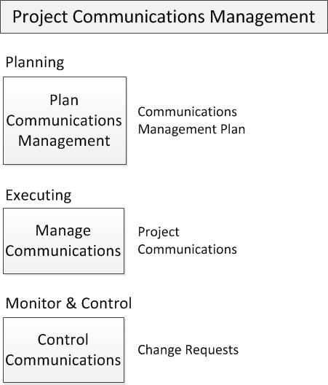
Project Communications Management

Slide 21
Communications Management Plan
What do stakeholders need to know?
What factors should be considered when planning communications?
Notes:
“Plan Communications Management is the process of developing an appropriate approach and plan for project communications based on stakeholder’s information needs and requirements, and available organizational assets”.
Do we use email, video conferences to communicate? What are their challenges, weekly or daily updates?

Slide 22
Manage Communications
Do you understand me?
Notes:
“This process goes beyond the distribution of relevant information and seeks to ensure that they information being communicated to project stakeholders has been appropriately generated, as well as received and understood. It also provides opportunities for stakeholders to make requests for further information, clarification, and discussion.

Slide 23
Control Communications
Are you getting what you need?
Notes:
“Control Communications is the process of monitoring and controlling communications throughout the entire project life cycle to ensure the information needs of the project stakeholders are met.”
Process of going back and asking do u have wat u need.

Slide 24
Group Project
Create HR Management Plan
Create Communications Plan

Slide 25
HR Management Plan
Create an HR Management Plan for your project
Include at least 5 different roles/responsibilities
Create a RACI table for your project
Create an org chart
Create a staffing plan
Communications Management Plan
Create a Communications Management Plan for your project
Include at least 5 different stakeholders and at least 3 different forms of communication
Create a status update for your project (assuming you are half way done)

Slide 26
PMP/CAPM Test Prep

Slide 27
Test Prep
Mnemonics for Memory Map
Practice questions

